Slide 1
Mobile Communication
Radio Propagation
and
Propagation Path-Loss Models
Radio wave Propagation
Wireless communication system consists of Tx and Rx.
The path from Tx to Rx is not smooth and the transmitted signal may go through various kinds of attenuations including path loss, multipath attenuation etc.
The signal attenuation through the path depends on various factors. They are time, radio frequency and path or position of transmitter/receiver.
The channel between transmitter and receiver can be time varying or
fixed depending upon whether the transmitter/receiver are fixed or moving with respect to each other.

Slide 2
8/5/20
Radio wave Propagation
In general, radio wave propagation consists of the following main attributes: attenuation reflection, diffraction and scattering
Reflection occurs when a radio wave collides with an object which has very large dimensions compared to the wavelength of the propagating wave.
Reflections are very commonly caused by the surface of the
earth and from buildings, walls, and other such obstructions.
Diffraction occurs when the radio path between the transmitter/receiver pair is obstructed by a surface with sharp edges.
This causes secondary waves to arise (in any conceivable direction) from the obstructing surface.
There is a possibility that the secondary waves can bend around
the obstacle and provide an almost artificial LOS between transmitter and receiver.

Slide 3
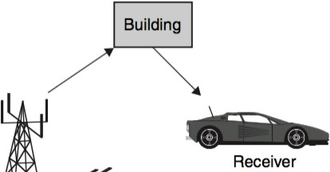
8/5/20
Diffraction is dependent on: frequency, amplitude, phase, and the angle of arrival of the incident wave.
Scattering occurs when the radio wave travels through a medium consisting of objects with dimensions that are small compared to the wave’s wavelength.
In such a case the number of such particles per unit volume are
usually very large.
Scattered waves arise when the radio wave meets rough surfaces or small objects in the channel.
Reflection

Slide 4
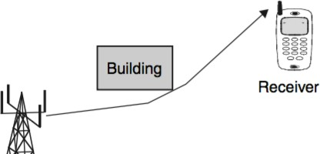
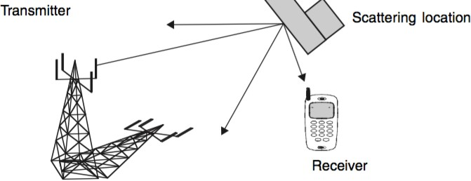
8/5/20
Diffraction
Scattering
CoICT – ETE
TE414

Slide 5
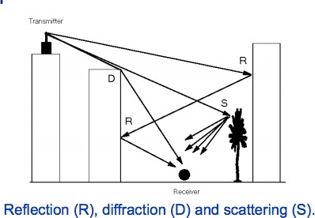
8/5/20
Multipath Propagation
Waves travel along different paths of varying lengths cause Multipath propagation
Interaction of these waves can be constructive or
destructive
What is Fading?
Fading refers to the variation of the signal strength with respect to different variables and is widely dominant in wireless transmissions.
These variables include time, geographical position, and radio frequency.
Fading is often modeled as a random process.
CoICT – ETE
TE414

Slide 6
8/5/20
What is Fading?
A fading channel is a communication channel that experiences fading.
In wireless systems, fading may either be due to multipath propagation, referred to as multipath-induced fading due to Weather (particularly rain), or shadowing from obstacles affecting the wave propagation, sometimes referred to as shadow
fading.
University of Dar es Salaam
What is Fading?.....
The time variation of received signal power due to changes in transmission medium or paths is known as fading.
Fading depends on various factors. In fixed scenario, fading depends on atmospheric conditions such as rainfall, lightening etc.
In mobile scenario, fading depends on obstacles over the path which are varying with respect to time.
These obstacles create complex transmission effects to the transmitted signal.

Slide 7
8/5/20
Types of Fading
Fading is used to describe fluctuations in the envelope of a transmitted radio signal.
When speaking of such fluctuations, one must consider whether a short observation interval (or small distance) has been taken, or whether a long observation interval (or large distance) has been taken.
Types of Fading
Small Scale Fading will show rapid fluctuations in the signal’s envelope
Large Scale Fading will give more of an slowly varying, averaged view.
CoICT – ETE
TE414

Slide 8
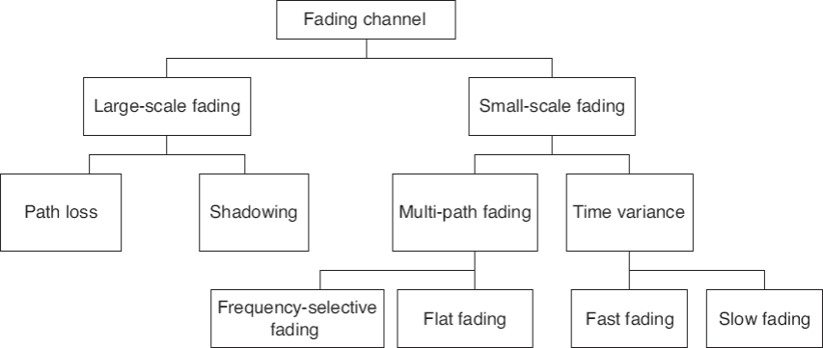
8/5/20
Fading types
Radio Wave Propagation Models
Channel properties influence the development of wireless communication systems.
Radio channels are extremely random and don’t offer easy analysis.
A Radio Wave Propagation Model (RWPM), is an empirical mathematical formulation for the characterization of radio wave
propagation as a function of frequency.

Slide 9
8/5/20
Radio Wave Propagation Models
In mobile radio systems, path loss models are necessary for proper planning, interference estimations, frequency assignments and cell parameters in network planning
Propagation models that predict the mean signal strength for an arbitrary transmitter-receiver separation distance which is useful in estimating the radio coverage area of a transmitter are called
large-scale propagation models, since they characterize signal strength over large T-R separation distances.
University of Dar es Salaam
Radio Wave Propagation Models
Radio propagation models are broadly classified into:
large-scale models and small-scale models.
Large scale effects typically occur in the order of hundreds to thousands of meters in distance.
Small scale effects are localized and occur temporally (in the order of a few seconds) or spatially (in the order of a
few meters).

Slide 10
8/5/20
Large Scale Propagation Models
The important questions in large-scale modeling are:
How the signal from a transmitter reaches the receiver
What is the relative power of the received signal with respect to the transmitted power level.
The transmitter and the receiver could be in line-of-sight (LOS) or in an environment surrounded by buildings,
trees and other objects.
Large Scale Propagation Models
As a result, the receiver may receive - a direct attenuated signal (also called as line-of-sight (LOS) signal) from the transmitter and indirect signals (or non-line-of-sight (NLOS) signal) due to other physical effects like reflection, refraction, diffraction and scattering.
Direct and indirect signals could also interfere with each
other.

Slide 11
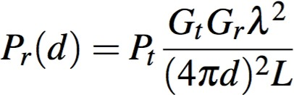
8/5/20
Friis Free-space Propagation Model
The most simple wave propagation case is that of a direct wave propagation in free space
In this special case of line-of-sight (LOS) propagation there
are no obstructions due to the earth’s surface or other obstacles
It models a single un-obstructed path between the transmitter
and the receiver.
The influence of all obstacles is ignored
Free-space Propagation Model
Applying the fact that the strength of a radiation field decreases as distance between Tx and Rx, the amount of power received relative to the power transmitted is given by:
Pr(d) is the received signal power (W)
d is separation between Tx and Rx
Pt is the power of the transmitted signal (W)
Gt and Gr are the gains of Tx and Rz
λ is the wavelength of carrier in meters
L represents other losses

Slide 12
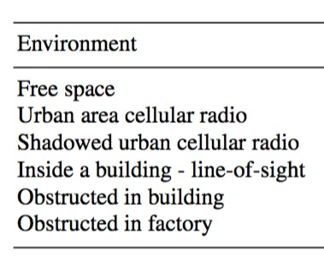
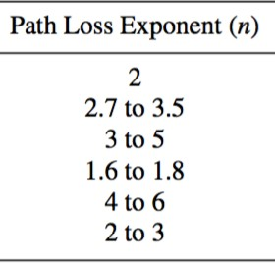

Free-space Propagation Model
The parameter L may include system losses like loss at the antenna, transmission line attenuation, loss at various filters etc.
The factor L is usually greater than or equal to 1 with L = 1 for no such system losses.
The Friis equation can be modified to accommodate different environments, on the reason that the received signal decreases as
the nth power of distance,
Free-space Propagation Model
Where the parameter n is the path-loss exponent (PLE) that takes constant values depending on the environment that is modeled

Slide 13

Free-space Propagation Model
The propagation path loss in free space, denoted as P_{L}, is the loss incurred by the transmitted signal during propagation when there are no obstacles.
It is expressed as the signal loss between the feed points of two isotropic antennas in free space.
Free-space Propagation Model
The variable λ exists in the path loss equation to account for the effective aperture of the receiving antenna, which is an indicator of the antenna’s ability to collect power.

Slide 14
Free-space Propagation Model
Usually, the transmitted power and the receiver power are specified in terms of dBm (power in decibels with respect to 1 mW)
Antenna gains in dBi (gain in decibels with respect to an
isotropic antenna).
Therefore, it is often convenient to work in log scale instead of linear scale.
Free-space Propagation Model
The alternative form of Friis equation in log scale is given by
4

Slide 15
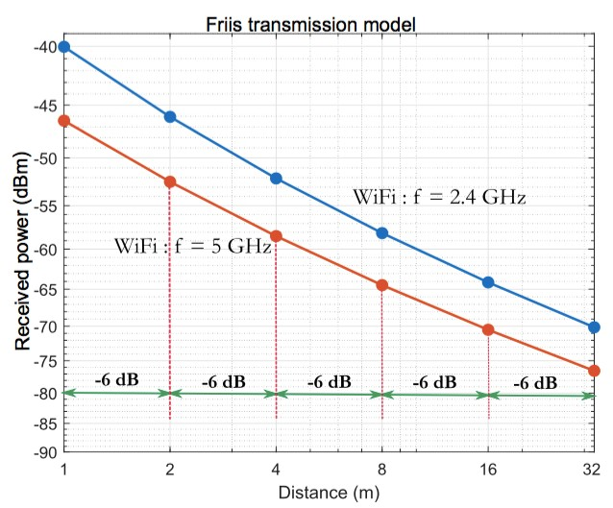
Free-space Propagation Model
Example: Consider a WiFi transmission-reception system operating at f = 2.4 GHz or f = 5 GHz band with 0 dBm (1 mW) output power from the transmitter. The gain of the transmitter antenna is 1 dBi and that of receiving antenna is 1 dBi. It is assumed that there is no system loss, therefore L
= 1. Plot the received power in dBm for a range of distance
University of Dar es Salaam
Plot of Pr(dBi) =f(d)
Using Free-space
Propagation model

Slide 16
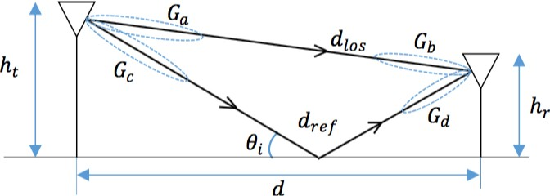
8/5/20
Two Ray Ground Reflection Model
Friis propagation model considers the line-of-sight (LOS) path between the transmitter and the receiver.
The expression for the received power becomes complicated if the effect of reflections from the earth surface has to be incorporated in the modeling.
In addition to the line-of-sight path, a single reflected
path is added in the two-ray ground reflection model
University of Dar es Salaam
Two Ray Ground Reflection Model

Slide 17

8/5/20
Two Ray Ground Reflection Model
This model takes into account the phenomenon of reflection from the ground and the antenna heights above the ground.
The ground surface is characterized by reflection coefficient -
R which depends on the material properties of the surface and the type of wave polarization.
The Tx and Rx antennas are of heights h_{t} and h_{r} respectively
and are separated by the distance of d meters.
Two Ray Ground Reflection Model
The received signal consists of two components: LOS ray that travels the free space from the transmitter and a reflected ray from the ground surface.
The received power due to reflected ray at a distance d from the Tx can be expressed as:

Slide 18
Two Ray Ground Reflection Model
Under the assumed conditions the received signal level depends only on the transmitted power, antenna heights, and separation distance. There is no frequency dependence
The received power falls of with distance raised to the fourth
power, or at a rate of 40dB/decade
This is a much more rapid path lost that is experienced in free space
University of Dar es Salaam
Two Ray Ground Reflection Model
The path loss for the 2-ray model(with antena gains) can be expressed in dB as

Slide 19
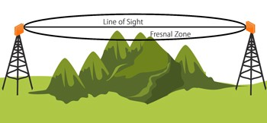
Fresnel zone
The Fresnel zone is a three-dimensional, concentric, ellipse which defines the pattern of radiation in radio transmissions (Theoretical Envelop)
Named after the physicist Augustin-Jean Fresnel.
These zones are used to calculate optimal signal transmission between two objects where obstructions are present.
University of Dar es Salaam
Fresnel zone

Slide 20
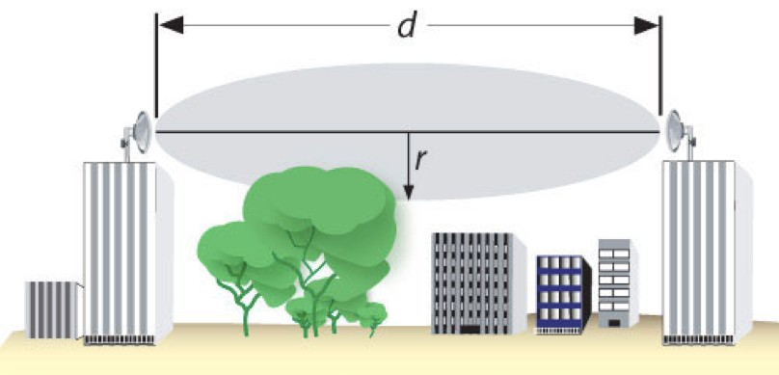
8/5/20
Fresnel zone
Fresnel zones
Is made up of multiple zones, Zone 1 being the strongest area for signal strength, followed by Zone 2 and Zone 3
There are many Fresnel zones, but only the first 3 have the any major effects on signal strength.

Slide 21
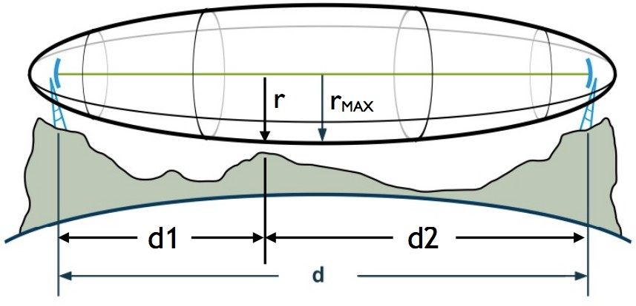
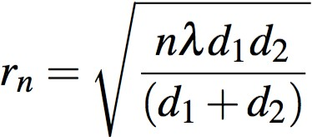
8/5/20
Fresnel zones
The Fresnel Zone clearance is important to the integrity of the RF link because it defines a volume around the LOS
that must be clear of any obstacle for the the maximum
power to reach the receiving antenna.
Objects in the Fresnel Zone as trees, hilltops and buildings can considerably attenuate the received signal, even when
there is an unobstructed line between the TX and RX
University of Dar es Salaam
Fresnel zones
The radius of the n^{th}
Fresnel zone is
approximated as

Slide 22

Fresnel zones
The radius of the 1st Fresnel zone is approximated as
University of Dar es Salaam
Single Knife-Edge Diffraction Model
Propagation environments may have obstacles that hinder the radio transmission path between the transmitter and the receiver.
Idealized models for estimating the signal loss associated
with diffraction by such obstacles are available
Considers two idealized cases where a sharp obstacle is placed between the transmitter and the receive

Slide 23
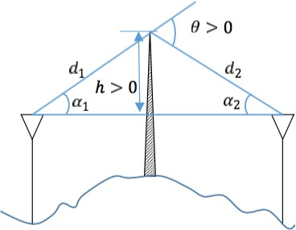
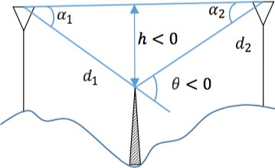
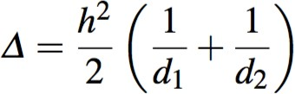
8/5/20
Single Knife-Edge Diffraction Model
University of Dar es Salaam
Single Knife-Edge Diffraction Model
For large-scale propagation geometry, the path difference between the LOS and the diffracted rays is:

Slide 24
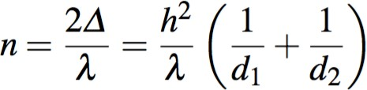
8/5/20
Single Knife-Edge Diffraction Model
Given the height of the obstruction h, we can find out which n^{th} Fresnel zone is obstructed by the obstruction.
Setting r_{n} = h and solving for n we get:
University of Dar es Salaam
Single Knife-Edge Diffraction Model
As general rule of thumb for point-to-point communication, if 60% of the first Fresnel zone is clear of obstructions, the diffraction loss would be negligible.
Any further Fresnel zone clearance does not
significantly alter the diffraction loss.

Slide 25
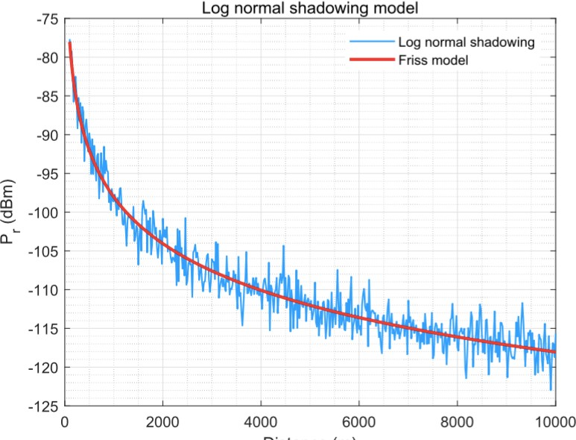
Log Distance Path Loss Model
It is also referred as log normal shadowing model
Log distance path loss model is an extension to the Friis free space model.
It is used to predict propagation loss for a wide range of environments
The model encompasses random shadowing effects due to
signal blockage by hills, trees, buildings etc..

Slide 26
Empirical Propagation Models
Empirical propagation models are based on measurement data, simple, use statistical properties, not very accurate.
There are many Empirical predication models including:
Okumura model
Hata model
COST 230, etc
Okumura Model for Outdoor Propagation
Outdoor propagation models involve estimation of propagation loss over irregular terrains such as mountain- ous regions, simple curved earth profile with obstacles like trees and buildings
In 1986, Yoshihisa Okumura traveled around Tokyo city and made measurements for the signal attenuation from base station to mobile station.

Slide 27
8/5/20
Okumura Model for Outdoor Propagation
He came up with a set of curves which gave the median attenuation relative to free space path loss.
Okumura came up with three sets of data for three scenarios:
Open area,
Urban area
Sub-urban area.
University of Dar es Salaam
Okumura Model for Outdoor Propagation
Okumura model was designed for use in the frequency range 150MHz up to 1920 MHz and mostly in an urban propagation environment.
Okumura's model is one of the most widely used models
for signal prediction in urban areas.
Distances of 1km to100km. It can be used for base station antenna heights ranging from 30m to1000m.

Slide 28
Okumura Model for Outdoor Propagation
Okumura developed a set of curves giving the median attenuation relative to frespace (A_{mu})
With a base-station effective antenna height (h_{te}) of 200m and a mobile antenna height (h_{re}) of 3m.
The curves are plotted as a function of frequency in the range100MHz to1920MHz and as a function of distance
from the base station in the range from 1km to100km.
Okumura Model for Outdoor Propagation
The Okumura Model is given by

Slide 29
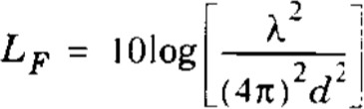
Okumura Model for Outdoor Propagation
^{L}50
L_{F}
A_{mu}(f,d)
^{G}(hte)
^{G}(hre)
^{G}AREA
= 50% value of propagation path loss (median)
= free space propagation loss
= median additional attenuation relative to free space
= base station antenna height gain factor
= mobile antenna height gain factor
= gain due to environment
Okumura Model for Outdoor Propagation
The free space path loss L_{F} can be calculated using equation

Slide 30
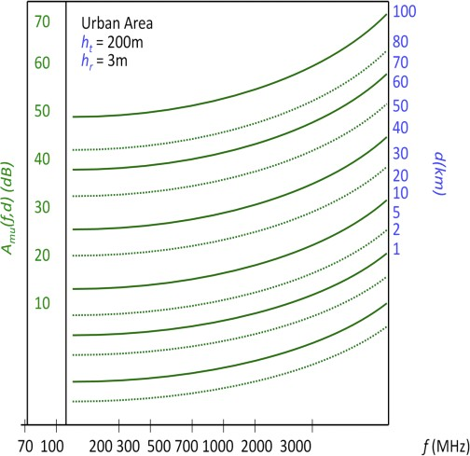
8/5/20
Okumura Model for Outdoor Propagation
The Basic Median Attenuation ( A_{mu} ) is the additional propagation losses due to the signal propagation in a terrestrial environment.
On the horizontal axis is the operating frequency in MHz.
On the vertical axis is additional path loss attenuation in dB.
The parameter of the family of the curves is the distance between the transmitter and receiver.
The curves are derived for TX height reference of 200m and RX height of 3m.
Basic median attenuation (A_{mu}) as a function of frequency and path distance
For example, at 850MHz frequency and the transmitter- receiver distance of 5km, the attenuation is close to 26dB.

Slide 31
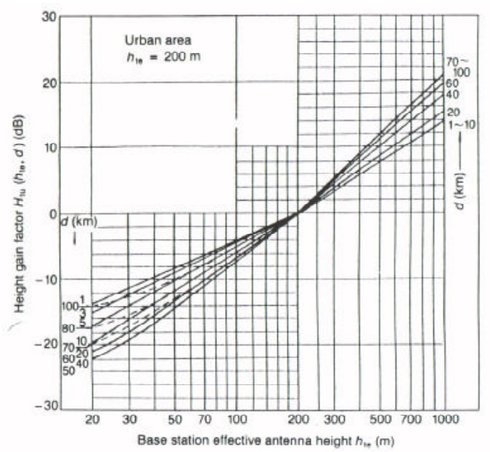
8/5/20
If the actual heights of the TX and RX differ from those referenced, the appropriate correction needs to be added
The curves used for correction of nonstandard transmitter and receiver heights are provided
At the effective height of 200m, all curves meet and no correction gain is required ( Htu =0dB).
Base station antennas above 200m introduce positive gain in the Okumura model and antennas lower than 200m have negative gain factor.
Base station height correction gain
For example, for 100m antennas and 1km distance, the base station antenna gain Htu is approximately –4dB.

Slide 32
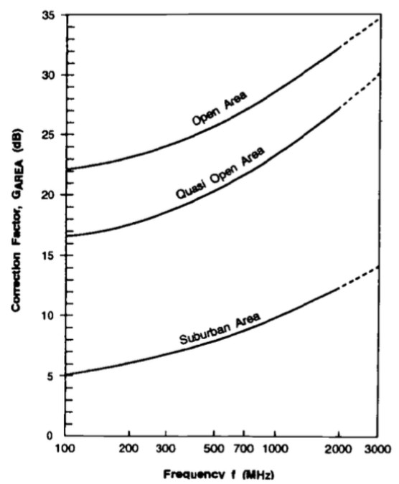
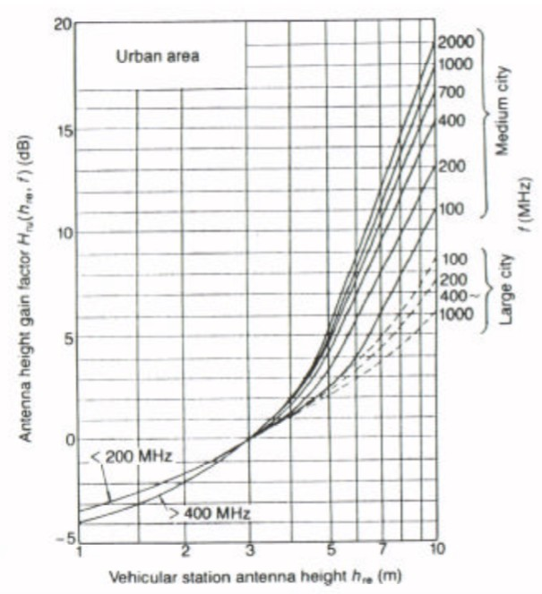
University of Dar es Salaam
Correction factor for
different types of
terrain
G_{AREA} represent
additional loss
correction factor
Mobile station height correction gain

Slide 33
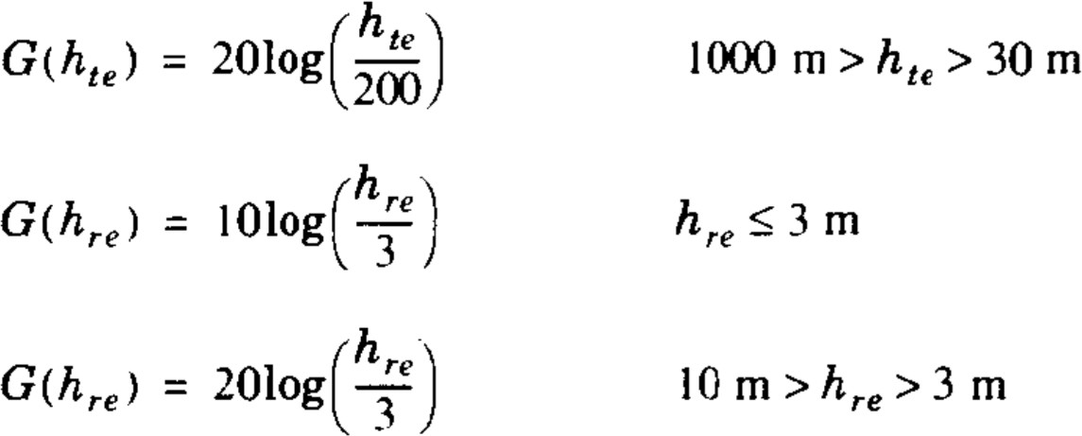
G_{(hte)} and G_{(hre)} can also be calculated using the following
Okumura's model is considered to be among the simplest and best in terms of accuracy in path loss prediction
The major disadvantage with the model is its slow response to rapid changes in terrain
Therefore the model is fairly good in urban and sub urban areas but not good in rural areas.

Slide 34
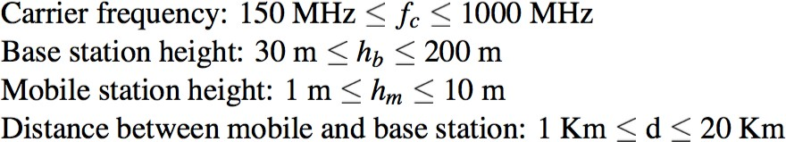
Hata Model
He extended the Okumura models to include effects due to diffraction, reflection and scattering of transmitted signals by the surrounding structures in a city environment.
Hata presented the urban area propagation loss as a standard formula and supplied correction equations for application to other situations.
Hata Model
Hata model is restricted to the following range of parameters:

Slide 35
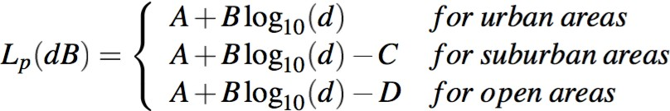
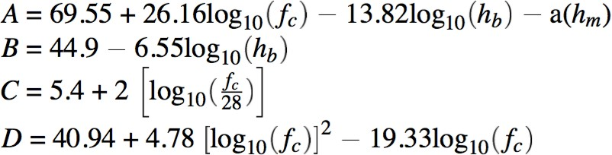
8/5/20
Hata Model
The path loss is given by:
Hata Model
Where:

Slide 36
Hata Model
The standard formula for median path loss in urban areas is given by:
a(h_{re}) is the correction factor for effective mobile antenna height which is a function of the size of the coverage area.
Hata Model
For a small to medium sized city, the mobile antenna correction factor is given by:

Slide 37
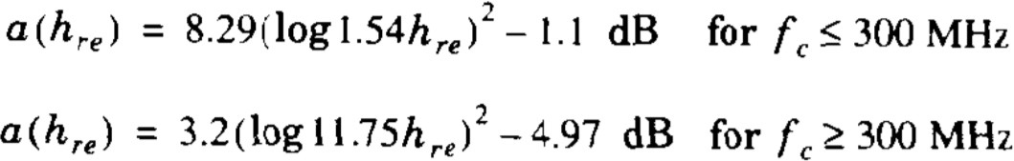
Hata Model
For a large city the antenna correction factor it is given by:
Hata Model
The path loss in a suburban area is given by:
The path loss in rural open area is given by:

Slide 38
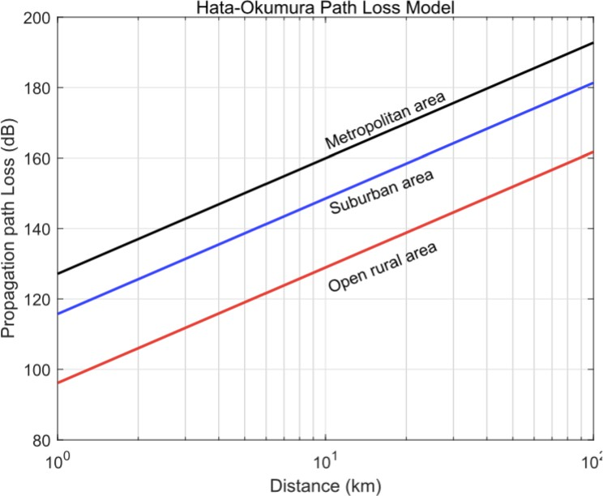
University of Dar es Salaam
Hata Model
Simulated distance vs. path
loss using Hata model, for
fc = 1500 MHz ,
h_{b} = 70m and
h_{m} = 1.5m
University of Dar es Salaam
Hata Model
The predictions of the Hata model compare very closely with the original Okumura model, as long as d exceeds 1 km.
This model is well suited for large cell mobile systems, but not personal communications systems (PCS) which have cells on the order of 1km radius.
For much smaller range of T-R separation distances, Indoor
Propagation models are used

Slide 39
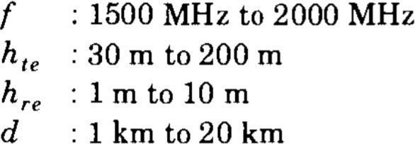
8/5/20
COST 231 Model
The European Co-operative for Scientific and Technical research (EURO-COST) formed the COST-231 working committee to develop an extended version of the Hata model.
COST-231 extended the Hata model to 2 GHz.
University of Dar es Salaam
COST 231 Model
The COST-231 extension of the Hata model is restricted to the following range of parameters:

Slide 40
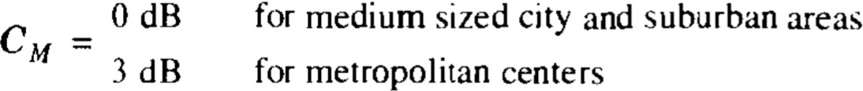
8/5/20
COST 231 Model
The COST-231 model path loss is given by:
CoICT – ETE
TE414
Indoor Propagation Models
These are radio propagation models that estimate path loss inside a room or a closed area inside a building delimited by walls of any form.
Suitable for appliances designed for indoor use
With the advent of Personal Communication Systems (PCS), there is a great deal of interest in characterizing radio propagation inside buildings.
CoICT – ETE TE414

Slide 41
8/5/20
Indoor Propagation Models
Outdoor Models are not accurate for Indoor scenarios e.g. Home, Shopping mall, office building, etc.
Indoor radio channel differs from traditional mobile radio channel in
Distances covered are much smaller.
Variability of the environment is greater for a much smaller range or T-R separation distances.
CoICT – ETE TE414
Indoor Propagation Models
The propagation inside a building is influenced by:
Layout of the building
Construction Materials
Building type: Traditional office building with fixed walls (Hard Partitions), Open plan buildings with movable wall panels (Soft Partitions), Sports Arena, Residential Home, Factory, etc

Slide 42
Indoor Propagation Models
Indoor and Outdoor propagation mechanism similarities:
Reflection, Diffraction, Scattering
Difference in conditions:
Doors/windows open or not
Mounting place of antenna (Desk, Ceiling )
The level of floors
Indoor Propagation Models
Indoor Channels are classified as:
Line-of-Sight (LOS)
Obstructed (OBS)
Indoor Path Loss Factors include:
Partition Losses (Same Floor)
Partition Losses between floors
Signal Penetration into Buildings

Slide 43
8/5/20
Indoor Propagation Models
The losses between floors of a building are determined by:
External dimensions and materials of the building
Type of construction used to create floors
External surroundings
Number of windows and doors
Indoor Propagation Models
RF signals can penetrate from outside transmitter to the inside of buildings
However the signals are attenuated
The path loss during penetration has been found to be a function of:
Frequency of the signal.
The height of the building.

Slide 44
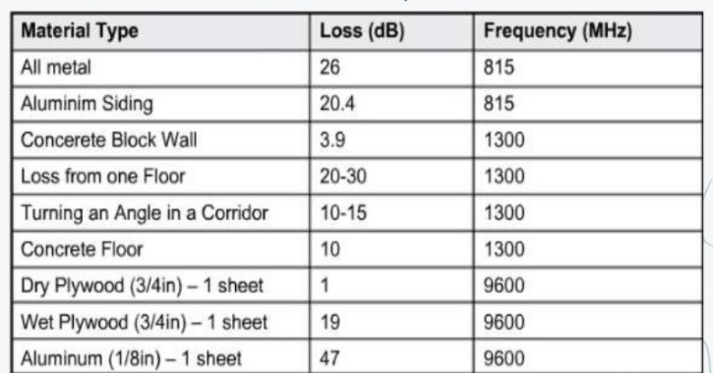
Same Floor Partition Loss
Partitions that are formed as part of the building structure are called hard partitions, and partitions that may be moved and which do not span to the ceiling are called soft partitions.
Partitions vary widely in their physical and electrical characteristics
Partition Attenuation Factor (PAF) has to be considered
University of Dar es Salaam
Same Floor Partition Loss
Average Signal Loss Measurements for Radio Paths Obstructed by Common Building Material.

Slide 45
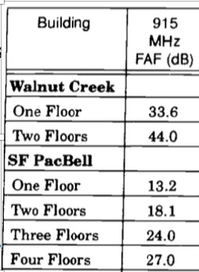
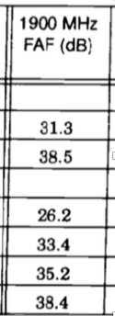
8/5/20
Partition Losses Between Floors
The losses between floors of a building are determined by:
External dimensions
Materials of the building
Type of construction used to create the floors
The external surroundings
Even the number of windows in a building and the presence of
tinting can impact the loss between floors
Floor Attenuation Factors (FAF) has to be considered
University of Dar es Salaam
Partition Losses
Between Floors
Sample Floor Attenuation
Factors (FAF)

Slide 46
8/5/20
Indoor Propagation Models
Models for Indoor Propagation include:
Log-Distance Path Loss Model
Attenuation Factor Model
ITU Indoor Path Loss Model
Ericsson Multiple Breakpoint Model
Log-distance Path Loss Model
Log distance path loss model is a generic model and an extension to Friis Free space model.
It is used to predict the propagation loss for a wide range of environments, whereas, the Friis Free space model is restricted to unobstructed clear path between Tx and Rx
Also known as Log Normal Shadowing Model
TE414

Slide 47

8/5/20
Log-distance Path Loss Model
Indoor path loss has been shown to obey the distance power law equation given by:
PL is the total path loss measured in Decibel (dB)
PL(d₀) is the free space path loss at the reference distance d₀ (in dB)
University of Dar es Salaam
Log-distance Path Loss Model
d is the length of the path in meters
d₀ is the reference distance; usually 1m
n is the path loss exponent depending on the surroundings and building type
X𝜎 is a random variable with zero mean, reflecting the attenuation (in decibel) caused by at fading. In case of no fading, this
variable is 0.

Slide 48
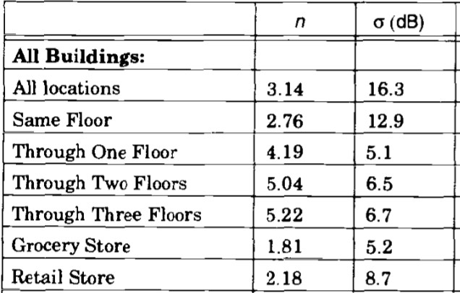
8/5/20
Log-distance Path Loss Model
Path Loss Exponent and Standard Deviation for Various Type of buildings
Attenuation Factor Model
This is an in-building propagation model that includes the effect of building type as well as the variations caused by obstacles
The model is given by:

Slide 49
8/5/20
Attenuation Factor Model
Where:
^{n}SF
= exponent value for the "same floor” measurement
FAF = path loss on a different floor

